Slide 2
Co-Authors
Makerere University, Uganda: Freddie Ssengooba, Lyn Atuyambe, Simon Kasasa, Susan Babirye, Steven Ssendagire
University of North Carolina: Grace Mulholland, Jessie K Edwards, William Miller, Lauren Zalla, Michael Herce, Nyanyiwe Mbeye, Whitney Ewing, Innocent Mofolo
Malawi NAC: Blackson Matatiyo, Shawn Aldridge
Malawi CEDEP: Victor Billy Gama
Key Populations Working Group, MeSH Consortium: Elizabeth Fearon, Stefan Baral, Amrita Rao, Brian Rice, James R Hargreaves

Slide 3
Funding
MEASURE Evaluation / USAID PEPFAR: Funded PLACE Uganda 2013 & Analysis & Interpretation & Participation in IAS Meeting
The Linkages Project / USAID PEPFAR: Funded PLACE Angola 2017
Global Fund / Malawi Grant: Funded PLACE Malawi 2017
Bill and Melinda Gates Foundation / MeSH: Analysis & Interpretation

Slide 4


Objectives
Apply prevention cascade frameworks in multiple datasets
Reflect on issues revealed by the cascades
Stroopwafel Cascade, Early Days
Stroopwafel Cascade, July 2018
As with the Stroopwafel Cascade, the HIV Prevention Cascade Recipe is still in the taste & test stage.

Slide 5
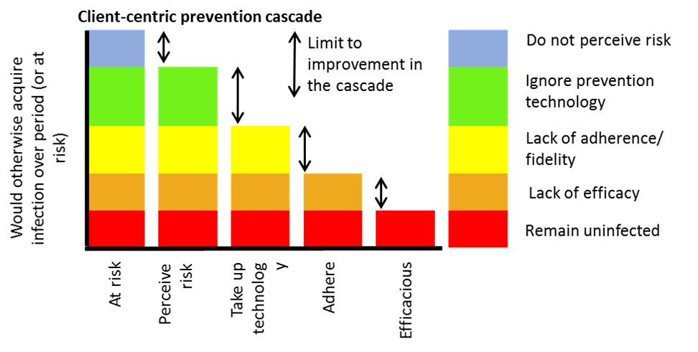
Methods
Hargreaves et al. Lancet cascade methods applied to the data
Data from PLACE studies in Uganda, Angola & Malawi
Focus on Condom cascades
Unweighted data shown
Populations
Female Sex Workers
MSM
Transgender Women
Men with 2 or More Partners in the Past 4 weeks

Slide 6
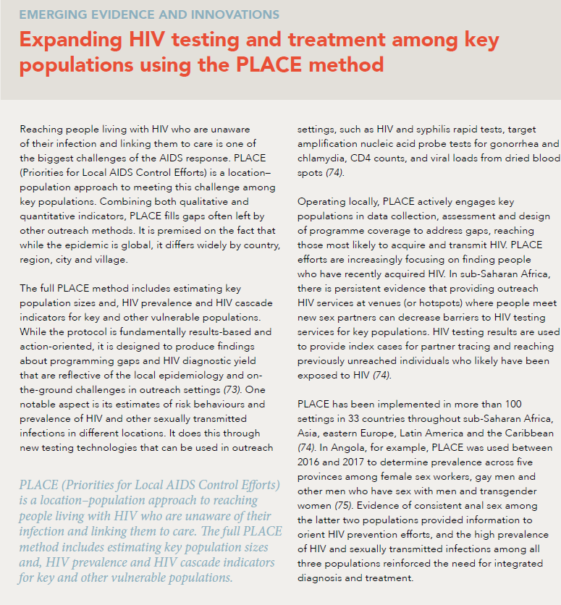
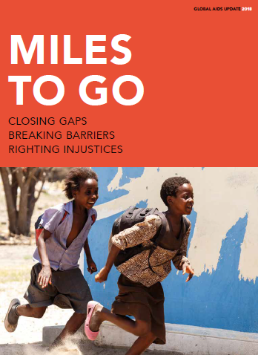
PLACE Method
Overview of PLACE Method
Engage stakeholders & select study areas
Systematically identify a complete list of physical venues in each area where people meet new sexual / needle-injecting partners
Visit, characterize, map venues
Interview & test a representative sample of venue patrons and workers
Use results to improve programs

Slide 7
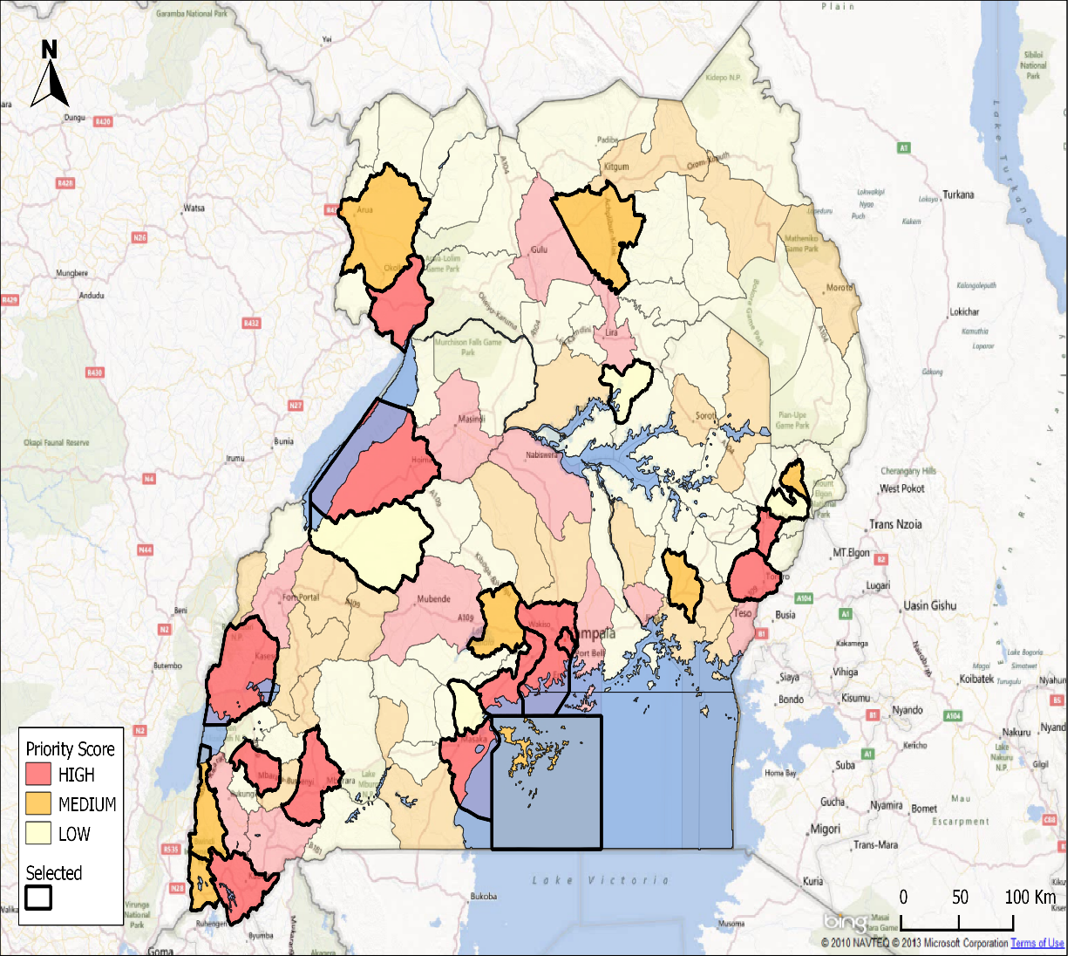
Measures: Uganda
Sex worker: Some people have sex with someone in exchange for gifts or help with expenses or for cash money. Have you received cash in exchange for sex in the past 12 months? Yes or No
Perceived Risk: How do you rate your chances of getting infected with HIV?
  No chance, Low vs
  Moderate, High, Not applicable, Already infected.
Uptake: Have you ever used a condom? Yes or No.
30 Districts Selected for PLACE Uganda, 2013
Selected Districts
High: 14 of 22
Medium: 10 of 29
Low: 6 of 60

Slide 8
Measures: Uganda
Supply/Availability: 2 Questions:
How easy or difficult is it for you to get a condom when you want one?
  Very Easy, Easy ,
  Not Easy, Very Difficult
  OR:
Do you have a condom with you? Yes
Adherence:
What best describes your intentions to use a condom?
  I do not use condoms and do not have plans to
  I probably should use condoms but I don’t
  I use condoms occasionally depending on the person3
  I try to use condoms every time but sometimes I don’t
  I have used condoms every time I have had sex in the past 6 months (Nobody reported this)

Slide 9
Uganda Prevention Cascades among FSW
Risk Perception Gap
978
Consistency Gap
Consistency Gap
546
Analysis of data from 1933 FSW uninfected with HIV
PLACE Uganda 2013 Funded by USAID / PEPFAR though MEASURE Evaluation

Slide 10
Measures: Angola
cash in exchange for sex in the past 12 months?
Sex worker: Some people have sex with someone in exchange for gifts or help with expenses or for cash money. Have you received cash in exchange for sex in the past 12 months? Yes or No
MSM: In the past 6 months, have you had anal sex with a man? Yes or No
Transgender Women: Assigned male sex at birth, identified as female or transgender and reported anal sex with a man in the past 6 months
Uptake: Used a condom at last sex for money; Used a condom at last anal sex
Adherence: Have you used a condom every time you’ve had anal/vaginal sex in the past 6 months? Yes or No
Supply: If you wanted a condom, would it be difficult for you to get one quickly? Yes or No

Slide 11
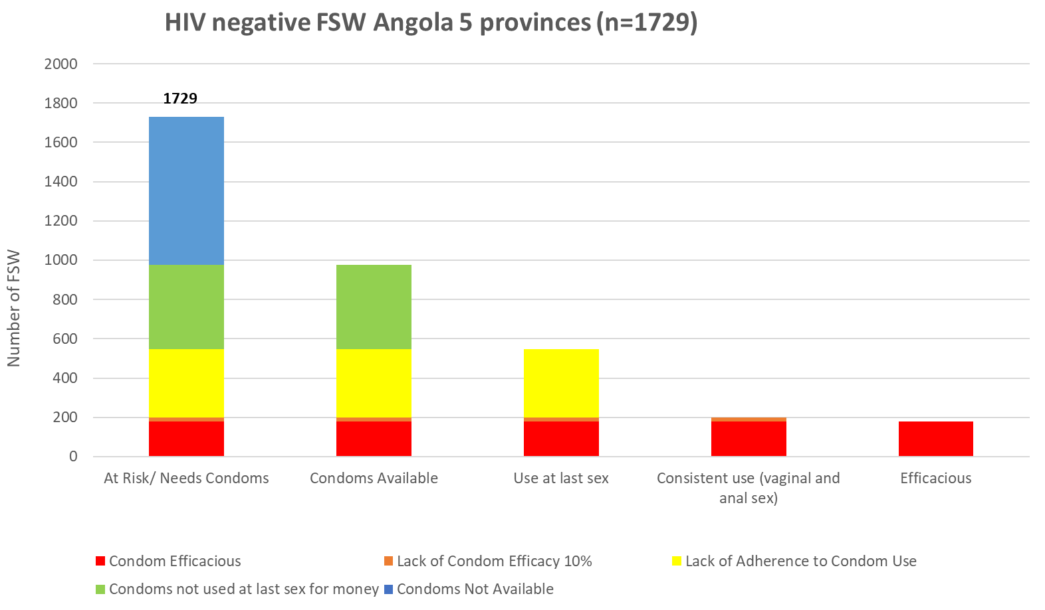
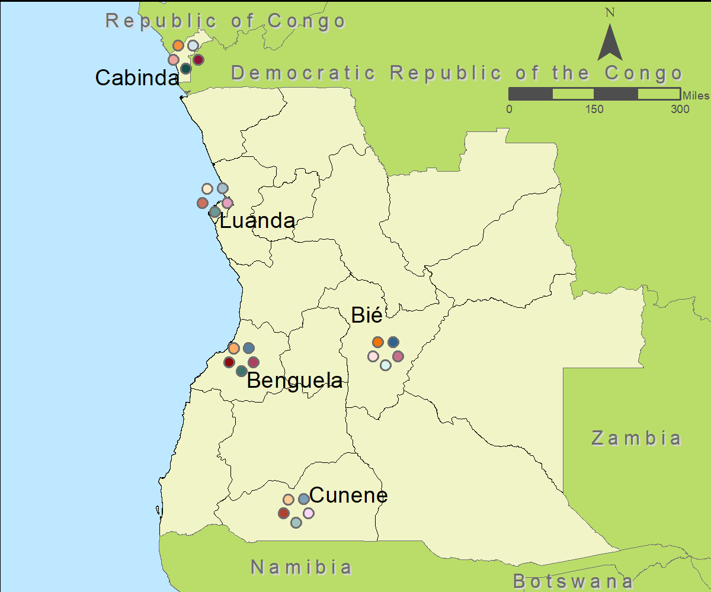
Angola Prevention Cascade among FSW
1729
Availability Gap
978
546
Consistency Gap
200
180

Slide 12
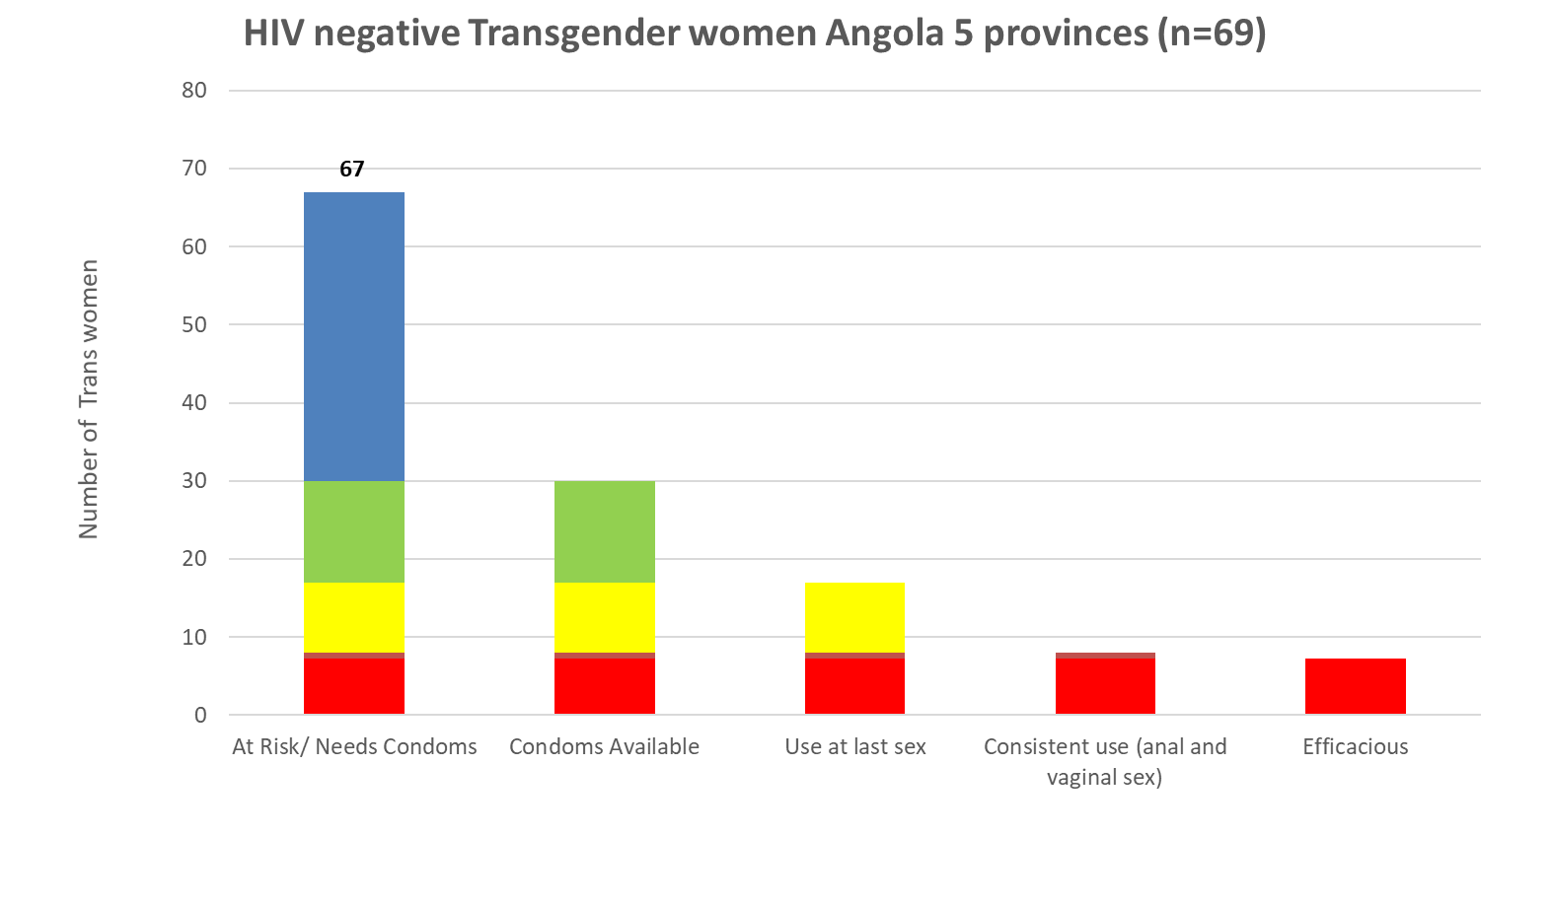
Angola: MSM and Transgender Women
HIV Negative Transgender Women Angola
67
Availability Gap
30
17
Consistency Gap
462
8
7
242
70
63=90%
Data are from PLACE Angola in 2017 with funding from USAID / PEPFAR through LINKAGES Project. The N shown is the number interviewed.
Notes:
HIV negative and had anal sex in the past 6 months

Slide 13
Malawi: Men with 2+ Partners in 4 Weeks Prevention Cascade among FSW
185
119
106
Preliminary Findings from 15 Districts in Malawi
27
24

Slide 14
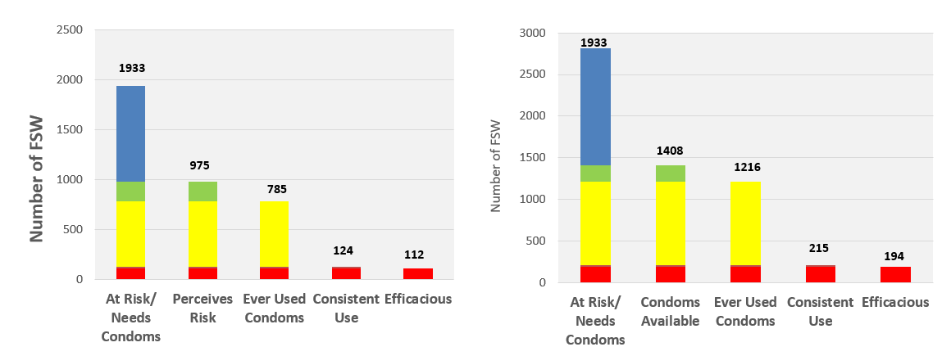
Reflection 1: Perceived Risk vs Availability
82.4% vs 82.4%
Condom Use by Condom Availability
Availability may be more useful to programs as an indicator. Risk perception may be better to explore as a factor in consistency of use.
But cascade may give the impression that availability is required in order for use to occur.
17.6% vs 17.5%

Slide 15
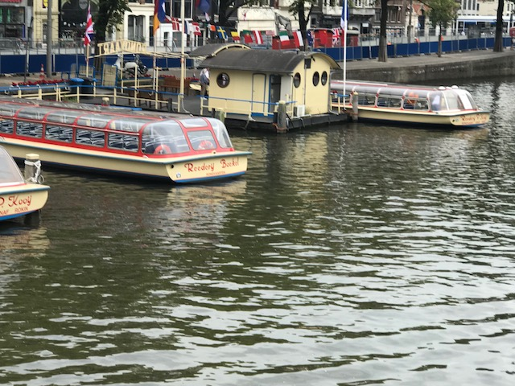
Reflection 2: Are we missing a boat?
Transmission risk Cascade focuses on acquisition risk rather than transmission risk.
Prevention among persons infected with HIV. Cascades do not incorporate the impact of viral suppression on preventing HIV Transmission
Condom use among HIV infected persons is just as important to monitor as among persons not infected.

Slide 16
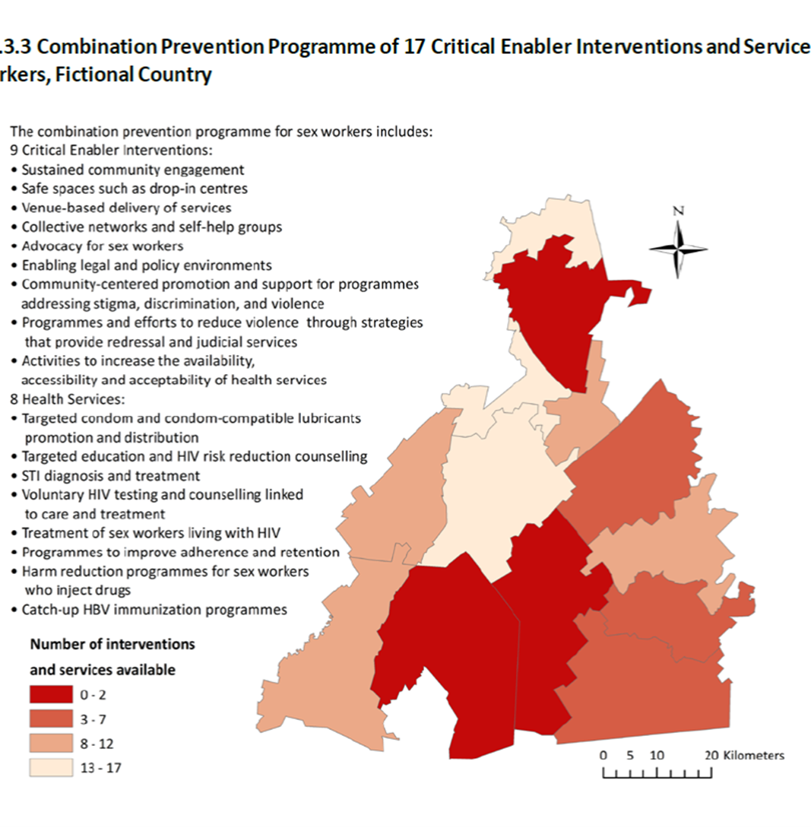
3: Incorporating Structural Interventions
Structural Interventions. Condom cascades struggle to incorporate structural level interventions
District Level Cascades showing the availability of a set of interventions in the district could supplement individual prevention cascades

Slide 17
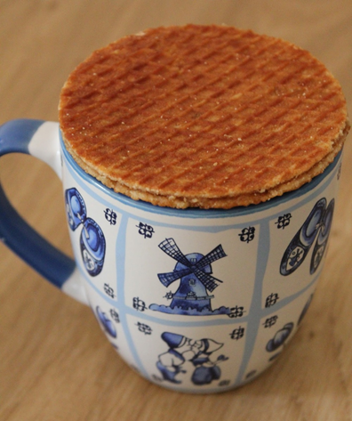
Summary
Prevention cascades can take advantage of the popularity of treatment cascades. Gaps in availability and consistency provide actionable insights.
Expanding to populations such as men with multiple partners can focus attention on underserved groups.
Definitions and size estimates of populations will affect cascades.
The focus on availability of the service and perceived risk are helpful for framing the cascade but more work on measuring availability and risk may improve measures.
More work to apply the cascade to persons infected with HIV and to integrate structural interventions and combination prevention could improve usefulness of the cascades.

